Slide 1

Chapter 7
Inheritance
Slides prepared by Rose Williams, Binghamton University
Kenrick Mock, University of Alaska Anchorage
Copyright © 2016 Pearson Inc. All rights reserved.

Slide 2
Introduction to Inheritance
Inheritance is one of the main techniques of object-oriented programming (OOP)
Using this technique, a very general form of a class is first defined and compiled, and then more specialized versions of the class are defined by adding instance variables and methods
  The specialized classes are said to inherit the methods and instance variables of the general class

Slide 3
Introduction to Inheritance
Inheritance is the process by which a new class is created from another class
  The new class is called a derived class
  The original class is called the base class
A derived class automatically has all the instance variables and methods that the base class has, and it can have additional methods and/or instance variables as well
Inheritance is especially advantageous because it allows code to be reused, without having to copy it into the definitions of the derived classes

Slide 4
Derived Classes
When designing certain classes, there is often a natural hierarchy for grouping them
  In a record-keeping program for the employees of a company, there are hourly employees and salaried employees
  Hourly employees can be divided into full time and part time workers
  Salaried employees can be divided into those on technical staff, and those on the executive staff

Slide 5
Derived Classes
All employees share certain characteristics in common
  All employees have a name and a hire date
  The methods for setting and changing names and hire dates would be the same for all employees
Some employees have specialized characteristics
  Hourly employees are paid an hourly wage, while salaried employees are paid a fixed wage
  The methods for calculating wages for these two different groups would be different

Slide 6
Derived Classes
Within Java, a class called Employee can be defined that includes all employees
This class can then be used to define classes for hourly employees and salaried employees
  In turn, the HourlyEmployee class can be used to define a PartTimeHourlyEmployee class, and so forth

Slide 7
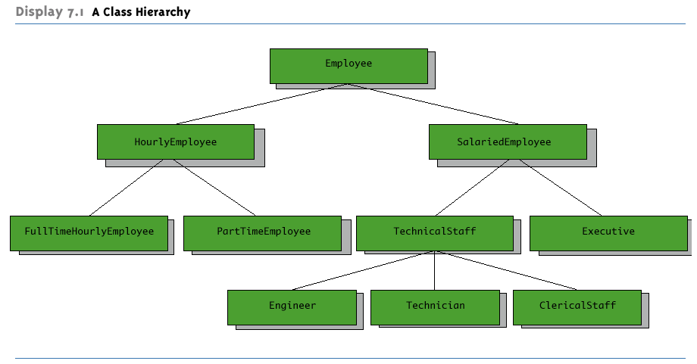
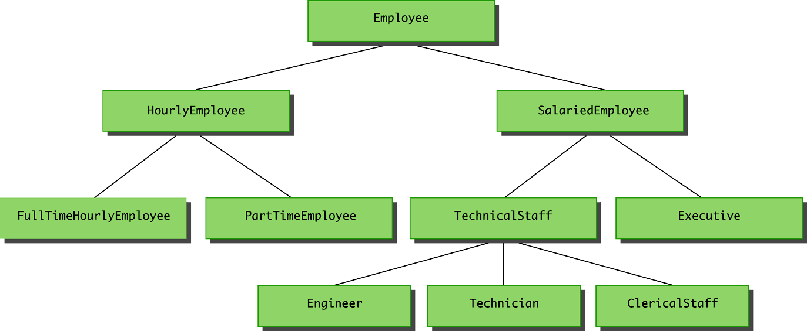
A Class Hierarchy

Slide 8
Derived Classes
Since an hourly employee is an employee, it is defined as a derived class of the class Employee
  A derived class is defined by adding instance variables and methods to an existing class
  The existing class that the derived class is built upon is called the base class
  The phrase extends BaseClass must be added to the derived class definition:
  public class HourlyEmployee extends Employee

Slide 9
Derived Classes
When a derived class is defined, it is said to inherit the instance variables and methods of the base class that it extends
  Class Employee defines the instance variables name and hireDate in its class definition
  Class HourlyEmployee also has these instance variables, but they are not specified in its class definition
  Class HourlyEmployee has additional instance variables wageRate and hours that are specified in its class definition

Slide 10
Derived Classes
Just as it inherits the instance variables of the class Employee, the class HourlyEmployee inherits all of its methods as well
  The class HourlyEmployee inherits the methods getName, getHireDate, setName, and setHireDate from the class Employee
  Any object of the class HourlyEmployee can invoke one of these methods, just like any other method

Slide 11
Derived Class (Subclass)
A derived class, also called a subclass, is defined by starting with another already defined class, called a base class or superclass, and adding (and/or changing) methods, instance variables, and static variables
  The derived class inherits all the public methods, all the public and private instance variables, and all the public and private static variables from the base class
  The derived class can add more instance variables, static variables, and/or methods

Slide 12
Inherited Members
A derived class automatically has all the instance variables, all the static variables, and all the public methods of the base class
  Members from the base class are said to be inherited
Definitions for the inherited variables and methods do not appear in the derived class
  The code is reused without having to explicitly copy it, unless the creator of the derived class redefines one or more of the base class methods

Slide 13
Parent and Child Classes
A base class is often called the parent class
  A derived class is then called a child class
These relationships are often extended such that a class that is a parent of a parent . . . of another class is called an ancestor class
  If class A is an ancestor of class B, then class B can be called a descendent of class A

Slide 14
Overriding a Method Definition
Although a derived class inherits methods from the base class, it can change or override an inherited method if necessary
  In order to override a method definition, a new definition of the method is simply placed in the class definition, just like any other method that is added to the derived class

Slide 15
Pitfall: Overriding Versus Overloading
Do not confuse overriding a method in a derived class with overloading a method name
  When a method is overridden, the new method definition given in the derived class has the exact same number and types of parameters as in the base class
  When a method in a derived class has a different signature from the method in the base class, that is overloading
  Note that when the derived class overloads the original method, it still inherits the original method from the base class as well

Slide 16
The super Constructor
A derived class uses a constructor from the base class to initialize all the data inherited from the base class
  In order to invoke a constructor from the base class, it uses a special syntax:
public derivedClass(int p1, int p2, double p3)
{
super(p1, p2);
instanceVariable = p3;
}
  In the above example, super(p1, p2); is a call to the base class constructor

Slide 17
The super Constructor
A call to the base class constructor can never use the name of the base class, but uses the keyword super instead
A call to super must always be the first action taken in a constructor definition
An instance variable cannot be used as an argument to super

Slide 18
The super Constructor
If a derived class constructor does not include an invocation of super, then the no-argument constructor of the base class will automatically be invoked
  This can result in an error if the base class has not defined a no-argument constructor
Since the inherited instance variables should be initialized, and the base class constructor is designed to do that, then an explicit call to super should always be used

Slide 19
Pitfall: The Terms "Subclass" and "Superclass"
The terms subclass and superclass are sometimes mistakenly reversed
  A superclass or base class is more general and inclusive, but less complex
  A subclass or derived class is more specialized, less inclusive, and more complex
    As more instance variables and methods are added, the number of objects that can satisfy the class definition becomes more restricted

Slide 20
Encapsulation and Inheritance Pitfall: Use of Private Instance Variables from the Base Class
If private instance variables of a class were accessible in method definitions of a derived class, then anytime someone wanted to access a private instance variable, they would only need to create a derived class, and access it in a method of that class
  This would allow private instance variables to be changed by mistake or in inappropriate ways (for example, by not using the base type's accessor and mutator methods only)

Slide 21
Pitfall: Private Methods Are Effectively Not Inherited
The private methods of the base class are like private variables in terms of not being directly available
However, a private method is completely unavailable, unless invoked indirectly
  This is possible only if an object of a derived class invokes a public method of the base class that happens to invoke the private method
This should not be a problem because private methods should just be used as helping methods
  If a method is not just a helping method, then it should be public, not private

Slide 22
Protected and Package Access
If a method or instance variable is modified by protected (rather than public or private), then it can be accessed by name
  Inside its own class definition
  Inside any class derived from it
  In the definition of any class in the same package
The protected modifier provides very weak protection compared to the private modifier
  It allows direct access to any programmer who defines a suitable derived class
  Therefore, instance variables should normally not be marked protected

Slide 23
Protected and Package Access
An instance variable or method definition that is not preceded with a modifier has package access
  Package access is also known as default or friendly access
Instance variables or methods having package access can be accessed by name inside the definition of any class in the same package
  However, neither can be accessed outside the package

Slide 24
Protected and Package Access
Note that package access is more restricted than protected
  Package access gives more control to the programmer defining the classes
  Whoever controls the package directory (or folder) controls the package access

Slide 25
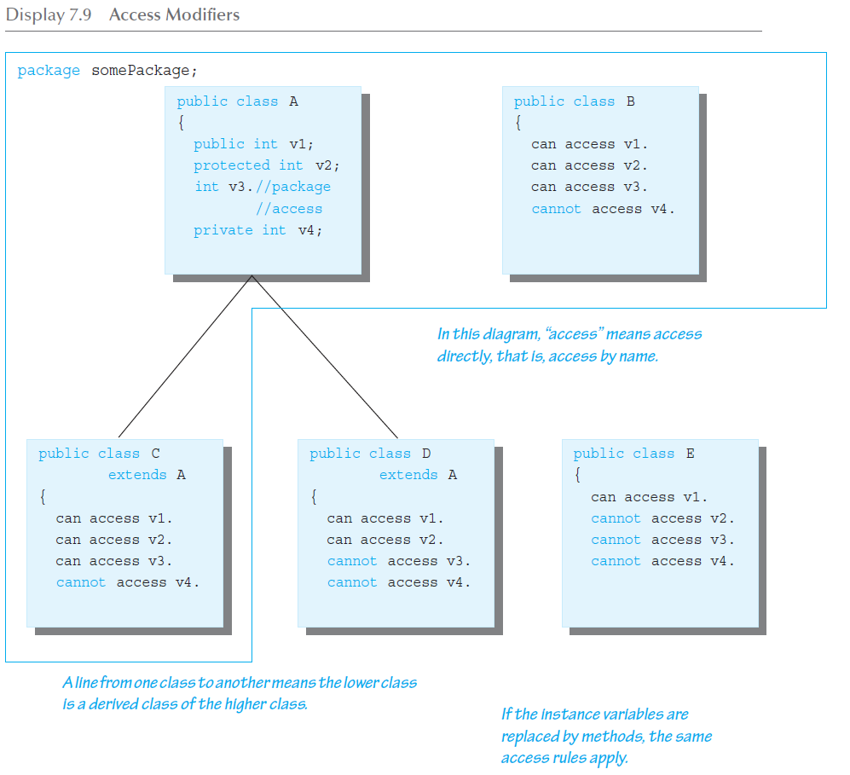
Access Modifiers

Slide 26
Pitfall: Forgetting About the Default Package
When considering package access, do not forget the default package
  All classes in the current directory (not belonging to some other package) belong to an unnamed package called the default package
If a class in the current directory is not in any other package, then it is in the default package
  If an instance variable or method has package access, it can be accessed by name in the definition of any other class in the default package

Slide 27
Pitfall: A Restriction on Protected Access
If a class B is derived from class A, and class A has a protected instance variable n, but the classes A and B are in different packages, then the following is true:
  A method in class B can access n by name (n is inherited from class A)
  A method in class B can create a local object of itself, which can access n by name (again, n is inherited from class A)

Slide 28
Pitfall: A Restriction on Protected Access
However, if a method in class B creates an object of class A, it can not access n by name
  A class knows about its own inherited variables and methods
  However, it cannot directly access any instance variable or method of an ancestor class unless they are public
  Therefore, B can access n whenever it is used as an instance variable of B, but B cannot access n when it is used as an instance variable of A
This is true if A and B are not in the same package
  If they were in the same package there would be no problem, because protected access implies package access

Slide 29
Tip: Static Variables Are Inherited
Static variables in a base class are inherited by any of its derived classes
The modifiers public, private, and protected, and package access have the same meaning for static variables as they do for instance variables

Slide 30
The Class Object
In Java, every class is a descendent of the class Object
  Every class has Object as its ancestor
  Every object of every class is of type Object, as well as being of the type of its own class
If a class is defined that is not explicitly a derived class of another class, it is still automatically a derived class of the class Object

Slide 31
The Class Object
The class Object is in the package java.lang which is always imported automatically
Having an Object class enables methods to be written with a parameter of type Object
  A parameter of type Object can be replaced by an object of any class whatsoever
  For example, some library methods accept an argument of type Object so they can be used with an argument that is an object of any class

